Slide 1


Track 5 : Access to Care – Open Topic
Measure Visual Acuity
Team: Absolute 6 Team No: 5.04
Notes:
Hello Everyone and welcome to nursehack4health!!! My Name is Hiyam Nadel and I am a founding member of Sonsiel and the director with the Center for Innovations in Care Delivery at Massachusetts General Hospital in Boston Mass. Before we begin, I want to take this opportunity to thank our sponsors : Johnson and Johnson, Microsoft, Sonsiel and Dev up because without their support, this event would not be possible
I have included how to pronounce my name in the chat .
While we wait for others to sign on, please introduce yourself , your name, your role and where you are from
I want everyone to know we will be recording this training so others or yourselves can review over time

Slide 2



Team: Absolute 6 Team No: 5.04
Notes:
Before we jump into the different framework, I do want to say a few things about Storrytelling.
You need to weave storytelling into your presentation. People love stories and remember stories. Stories draw us in and connects us to you and the problem you are trying to solve. It makes us feel like we want to solve the problem with you! Let your story have a good beginning , middle and end. The components are generally the set up, the struggle, the solution and finally, the wrap up. Storyteling is very crucial in a pitch!

Slide 3
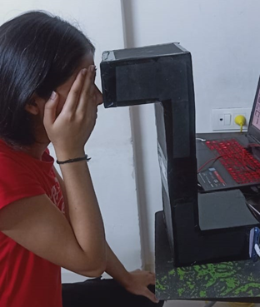

Implementation
Team: Absolute 6 Team No: 5.04

Slide 4
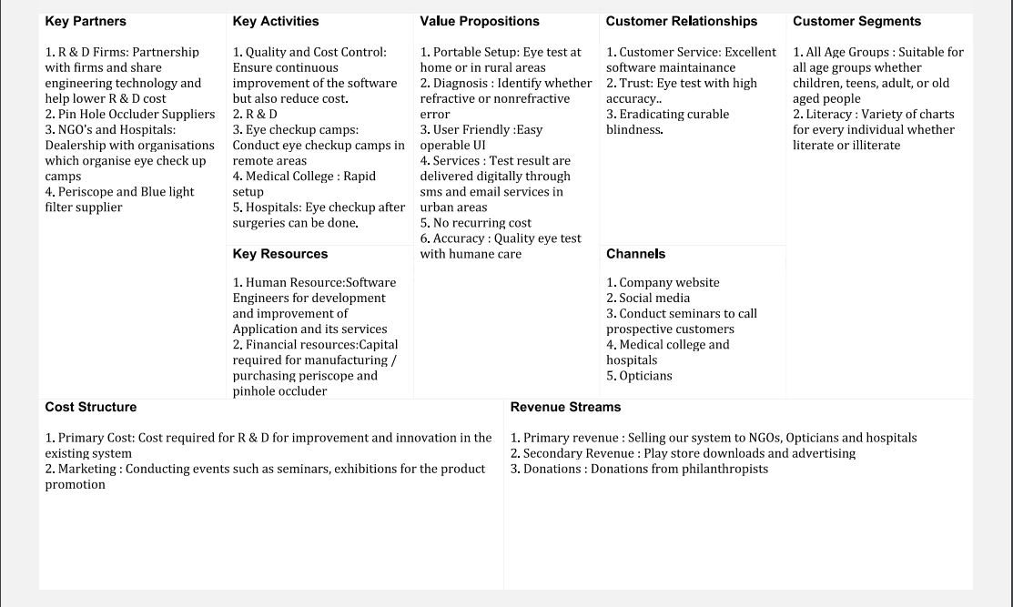
Team: Absolute 6 Team No: 5.04

Slide 5
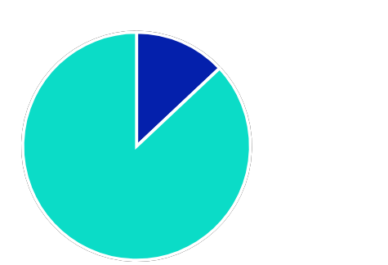
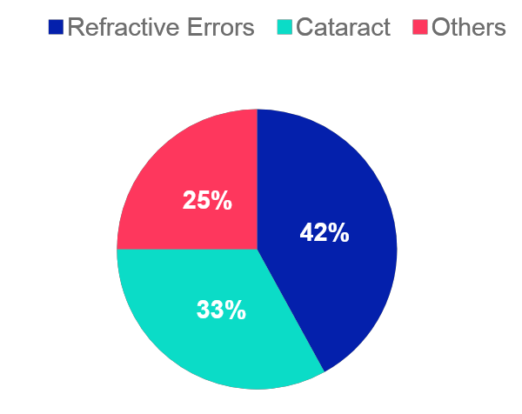
Market Potential
Team: Absolute 6 Team No: 5.04
285 million
Causes of Visual Impairment
285 million people are visually impaired globally
Refractive Errors and Cataract cause 75% of global visual impairment
39 million people are blind.
246 million have low vision
13%
.

Slide 6
Team: Absolute 6 Team No: 5.04
“I watch people get older and lose their visual acuity; you lose that sharpness, that cleanness, that brain that you worked so hard on and that you were gifted with and lose the gifts that were given.”
– Bryce Courtenay

Slide 7
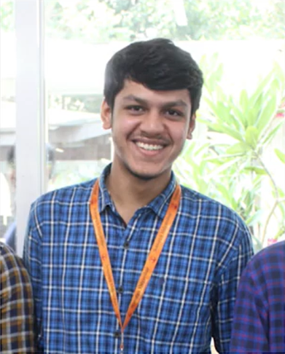
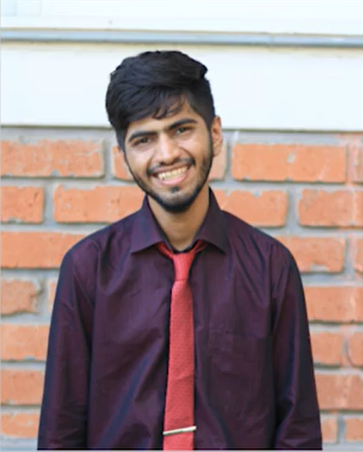
Team Members
Team: Absolute 6 Team No: 5.04
Dharmin Chothani (Team Lead)
Computer Engineer, India
A computer engineering student with great research potential and good problem solving skills.
Nayan Bhatia
Computer Engineer, India
To continuously enhance my knowledge, skills and experience by getting involved in challenging work environment and utilize them for personal and organization growth to the best of my ability.

Slide 8
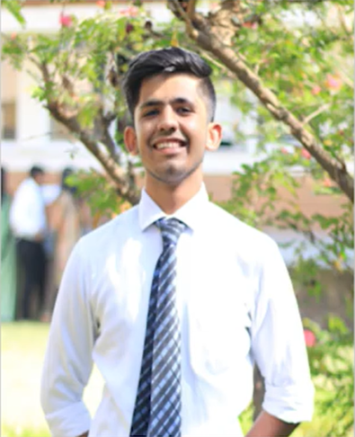
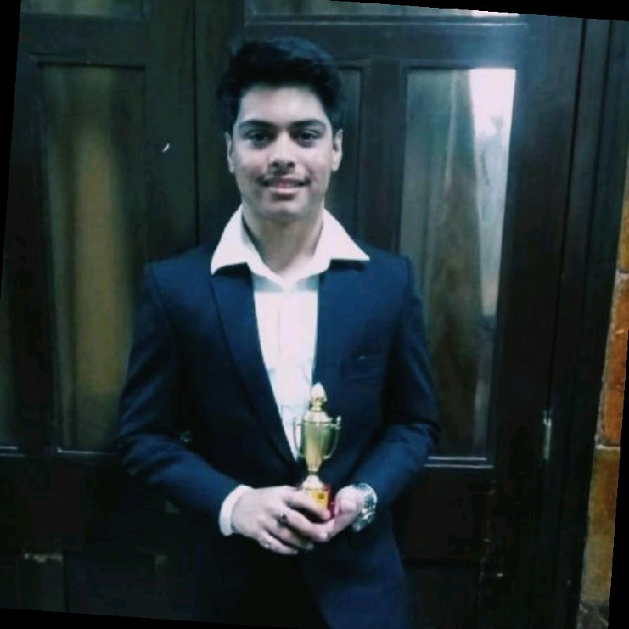
Team Members
Team: Absolute 6 Team No: 5.04
Kartik Chawda
Computer Engineer, India
Web and Android Application Developer. Experienced with development cycle with dynamic projects.
Cherag Bolakani
IT Engineer, India
A research oriented engineering enthusiast working towards creating Innovative solutions for a better change.
Notes:
An enthusiastic final year computer engineering student

Slide 9
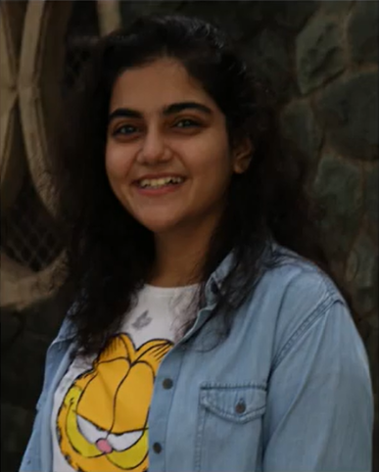
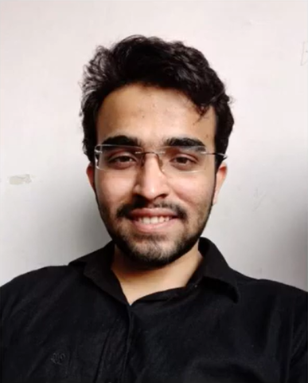
Team Members
Team: Absolute 6 Team No: 5.04
Juhi Gori
Computer Engineer, India
I am a UI/UX designer. This helps me create products considering development constraints in mind. My goal is to create products that are user-centric and comply with the business goals.
Keval Dave
Computer Engineer, India
A deep learning enthusiast, has learnt about neural networks from the fundamentals along with the mathematics involved and the terminologies
Notes:
An enthusiastic final year computer engineering student

